Slide 1
CAD
B-Spline basis functions
Recursion relation

Slide 2
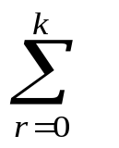
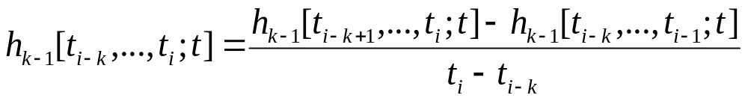
Leibnitz result
divided differences of the product of two functions, h(t) = f(t)g(t)
h[t₀, t₁,…,t_{k}] =
f[t₀, t₁, …,t_{r}] g[t_{r}, t₁, …,t_{k}]
= f[t₀]g[t₀, t₁, …,t_{r}] + f[t₀, t₁]g[t₁, …,t_{k}] + … +
f[t₀, t₁, …,t_{k−1}]g[t_{k−1},t_{k}] + f[t₀, t₁, …,t_{k}] g[t_{k}]
h_{k} (t_{j}; t) = (t_{j} − t) ^{k−1}₊ = (t_{j} − t) ^{k−2}₊ (t_{j} − t) ₊ = h_{k−1}(t_{j}; t) (t_{j} − t) ₊
h_{k}[t_{i−k},..., t_{i};t ] = h_{k−1}[t_{i−k},…, t_{i−1};t] + h_{k−1}[t_{i−k},…, t_{i};t](t_{i} − t)
k th divided difference of (t_{j} − t) ^{k−1}₊ :
B-spline M_{k, i}(t)
M_{k-1,i-1}(t)

Slide 3
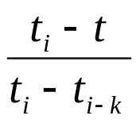
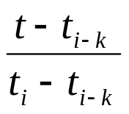
Recursion relation
h_{k}[t_{i−k},..., t_{i};t ] = h_{k−1}[t_{i−k},…, t_{i−1};t] + h_{k−1}[t_{i−k},…, t_{i};t](t_{i} − t)
M_{k, i}(t)
=
M_{k−1,i−1}(t)
+
{h_{k−1}[t_{i−k+1},…, t_{i};t ] − h_{k−1}[t_{i−k},…, t_{i−1};t]}
M_{k, i}(t)
=
M_{k−1,i−1}(t)
+
{M _{k−1, i}(t) − M _{k−1, i−1}(t)}
M_{k, i}(t)
=
M_{k−1,i−1}(t)
+
M _{k−1, i}(t)
similar to the de Casteljau’s algorithm
repeated linear interpolation is performed between two consecutive splines
a table to construct splines may also be generated

Slide 4
Table to construct
B-splines
t_{i−k}, t_{i−k+1} | M_{1,i− k+1}(t)
 |  | M_{2,i− k+2}(t)
t_{i−k+1}, t_{i−k+2} | M_{1,i− k+2} (t)
 |  | M_{2,i− k+3}(t)
t_{i−k+2}, t_{i−k+3} | M_{1,i− k+3} (t)
 |  |  | M_{k−1,i−1}(t)
 |  |  |  | M_{k,i}(t)
 |  |  | M_{k−1,i}(t)
t_{i−3}, t_{i−2} | M_{1,i−2}(t)
 |  | M_{2,i−1}(t)
t_{i−2}, t_{i−1} | M_{1,i−1}(t)
 |  | M_{2,i}(t)
t_{i−1}, t_{i} | M_{1,i}(t)

Slide 5
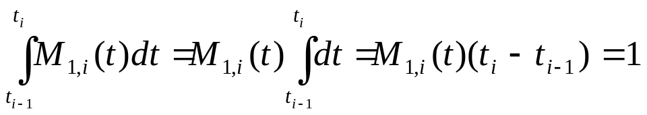
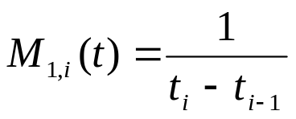
Order one B-splines
M_{k, i}(t) is non-zero in the knot span t_{i−k}≤ t ≤ t_{i} and zero elsewhere
M_{1, i}(t) is non-zero only in one span, t_{i−1} ≤ t ≤ t_{i}
M_{1, i}(t) is constant in t_{i−1} ≤ t ≤ t_{i}
can be computed using the standardization condition
for t ∈ [t_{i− 1}, t_{i})
= 0 elsewhere

Slide 6
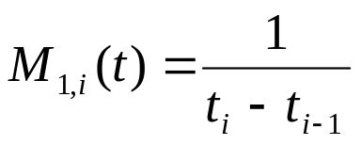
Overall recursion relation
for t ∈ [t_{i− 1}, t_{i})
= 0 elsewhere
M_{k, i}(t)
=
M_{k−1,i−1}(t)
+
M _{k−1, i}(t)
for t ∈ [t_{i− k}, t_{i})
= 0 elsewhere

Slide 7
Graphic Depiction
1
M_{1,3}
M_{4,4}
M_{1,1}
0.5
M_{1,2}
M_{1,4}
M_{2,3}
M_{2,2}
M_{2,4}
M_{3,3}
M_{3,4}
0
2
5
6
10
0
1
2
3
4

Slide 8
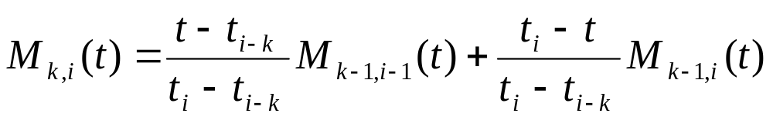
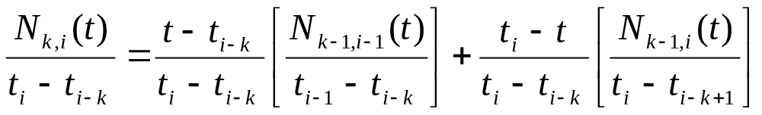
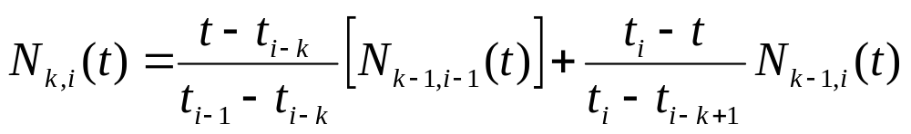
Normalized B-splines
More popular
N_{k, i}(t) = (t_{i} − t_{i− k})M_{k, i}(t)
N_{1, i} (t) = δ_{i} such that δ_{i} = 1 for t ∈ [t_{i− 1}, t_{i})
= 0, elsewhere

Slide 9
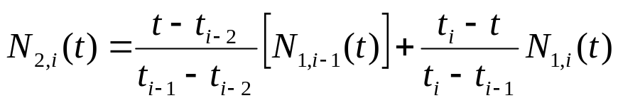
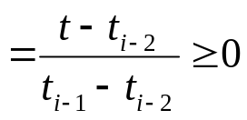
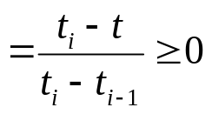
Properties of
Normalized B-splines
N_{k, i}(t) is a degree k−1 polynomial in t
Non-negativity: For all i, k and t, N_{k, i}(t) is non-negative
In a given knot span t_{i−k} < t_{i−k +1} < …< t_{i}
N_{1, i}(t) = 1, for t ∈ [t_{i− 1}, t_{i}); = 0, elsewhere
N_{1, i}(t) ≥ 0 in [t_{i− k}, t_{i})
  N_{1, i−1}(t) = 1, for t ∈ [t_{i− 2}, t_{i− 1}); = 0, elsewhere
N_{1, i−1}(t) ≥ 0 and N_{1, i−2}(t) ≥ 0
in [t_{i− k}, t_{i})
N_{1, i−2}(t) = 1, for t ∈ [t_{i− 3}, t_{i− 2}); = 0, elsewhere
t ∈ [t_{i− 2}, t_{i}) and = 0, elsewhere
N_{2, i}(t) ≥ 0 for t in [t_{i− k}, t_{i})
for t ∈ [t_{i− 2}, t_{i− 1})
Perform induction to prove for
N_{k,i}(t)
for t ∈ [t_{i− 1}, t_{i})

Slide 10
Example
N_{4,4}(t)
N_{1,1}(t)
N_{1,2}(t)
N_{1,3}(t)
N_{1,4}(t)
N_{2,3}(t)
N_{3,3}(t)
N_{2,2}(t)
N_{3,3}(t)
N_{3,4}(t)
0
1
2
3
4

Slide 11
Properties of
Normalized B-splines …
N_{k,i}(t) is a non-zero polynomial in (t_{i−k}, t_{i})
On any span [t_{i}, t_{i+1}), at most p order p normalized B-Splines are non-zero
provides local control for B-spline curves
N_{4,i+2}(t)
N_{4,i+3}(t)
N_{4,i+1}(t)
N_{4,i+4}(t)
t_{i-4}
t_{i-3}
t_{i-2}
t_{i-1}
t_{i}
t_{i+1}
t_{i+2}
t_{i+3}
t_{i+4}
t
For any r, N_{p,r}(t) ≥ 0 in the knot span [t_{r−p}, t_{r})
If [t_{i}, t_{i+1}) is contained in [t_{r−p}, t_{r}),
there should be one order p B-spline with t_{i} as the first knot and one with t_{i+1} as last knot
r−p = i and r = i+1 provide the range
r = i+1, …, i+p
p splines

Slide 12
Properties of
Normalized B-splines …
  Partition of Unity: The sum of all non-zero order p basis functions over the span [t_{i}, t_{i+1}) is 1
N_{4,i+2}(t)
N_{4,i+3}(t)
N_{4,i+1}(t)
N_{4,i+4}(t)
t_{i-4}
t_{i-3}
t_{i-2}
t_{i-1}
t_{i}
t_{i+1}
t_{i+2}
t_{i+3}
t_{i+4}
t
B-spline basis functions add to unity within a subgroup
Not all B-spline basis functions add to one as opposed to Bernstein
polynomials

Slide 13
Properties of
Normalized B-splines …
For number of knots as m+1 and the number of degree p–1 basis functions
as n+1, m = n + p
The first normalized spline on the knot set [t₀, t_{m}) is N_{p,p}(t)
the last spline on this set is N_{p,m}(t)
m− p+1 basis splines
n+1 = m− p+1
Multiple knots
If a knot t_{i} appears k times (i.e., t_{i−k+1} = t_{i−k+2} = ... = t_{i}), where k > 1,
t_{i} is termed as a multiple knot or knot of multiplicity k
for k = 1, t_{i} is termed as a simple knot
Multiple knots can significantly change the properties of basis functions and are
useful in the design of B-spline curves

Slide 14
Properties of
Normalized B-splines …
  At a knot i of multiplicity k, the basis function N_{p i}(t) is C^{p −1− k} continuous at that knot
1
0.8
N_{3,i}(t)
0.6
0.4
0.2
0
1
2
3
4

Slide 15
Properties of
Normalized B-splines …
Symmetricity is maintained when knots are moved to the left
1
0.8
N_{3,i}(t)
0.6
0.4
0.2
0
1
2
3
4

Slide 16
Properties of
Normalized B-splines …
  At each internal knot of multiplicity k, the number of non-zero order p
  basis functions is at most p− k
N_{4,i-3}
N_{4,i-2}
N_{4,i-1}
t_{i-7}
t_{i-6}
t_{i-5}
t_{i-4}
t_{i-3}
t_{i-2}
t_{i-1}
non-zero splines over a simple knot t_{i−4}
p − k = 4 − 1 = 3
non-zero splines over a double knot t_{i−4}
p − k = 4 − 2 = 2
non-zero splines over a triple knot t_{i−4}
p − k = 4 − 3 = 1
non-zero splines over a quadruple knot t_{i−4}
p − k = 4 − 4 = 0

